Slide 1
COMP 2920 : Software Architecture & Design

Slide 2
Class Schedule
Lecture : Mon (OM2216), Tues & Friday (OM 1355) Time – 12:30 – 1:20 Seminar : Wednesday (OM 1355) Time - 3:30 – 4:20

Slide 3
Assessment
Assessment | Percentage | Date
Assignments & Lab | 20% | TBA
Mid Term I | 25% | 18th October (Wednesday)
Project & Presentation | 15% | Last week of the course
Final | 40%

Slide 4
Course Outline
Define Software Architecture and Modelling
Identify both functional and non-functional requirements of a software system.
Use a design paradigm to design a simple software system.
Construct models of the design of a simple software system.
Articulate and evaluate software architecture of a simple system.
Apply simple examples of patterns in a software design.
Understand the intellectual property of a software design.

Slide 5
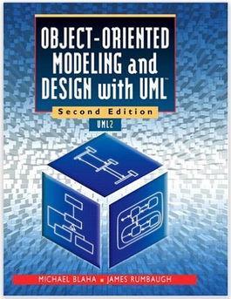
Literature
Provides a proven software development process for using the most important concepts and notation of UML 2.0
Includes iterative development with use cases, activity models, and sequence diagrams for a more robust process.

Slide 6
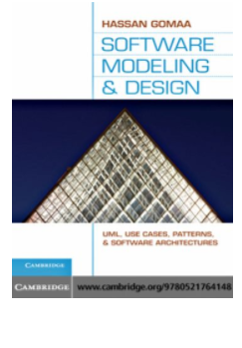
Hassan Gomaa
Software Modeling and Design (UML, Use Cases, Patterns, & Software Architectures)

Slide 7

Book-2
Covers the topics like
Architecture Views,
Context of software architecture in business,
technical, stakeholders,
Designing an architecture,
Quality attributes of software architecture,
Architecture Evaluation

Slide 8

Intellectual Property
Introduces to the concepts of Ethics in the Information Era
Mainly covers the Intellectual; property issues

Slide 9
Chapter Topics
Explain the development process
Define requirements
Requirements discovery
Domain Analysis

Slide 10
Software Development Methodologies
Software development consists of a wide spectrum of activities that individual methodologies cover selectively and from different viewpoints.

Slide 11
Software Development Methodologies Address:
Problem definition
Requirements Gathering
This activity determines the requirements that the product must address.
Feasibility Study
Determines whether it is possible — technically, economically, legally or organizationally — to build a certain software.
Domain Analysis
Discovers ❶ the meaning of requirements within the context, ❷ concepts within the domain that are related to the problem and can affect the solution, and possibly ❸ the consequences of the solution on the problem domain.
Analysis
Analyzing the requirements to build a conceptual model of the solution (the product).
Design
Transforms the “what” into “how.” Design itself consists of several distinct activities; logical design, physical design, and architectural design.

Slide 12
Software Development Methodologies Address:
Implementation
Turns the blueprints of design into an actual product. Programming is usually the most important component of this activity, but it is not the only one.
Testing and Quality Control
Verifies that the product functions according to specifications.
Deployment and Training
This activity consists of ensuring the correct installation on the target platform, user training, creating help files and user manuals, setting up of Web sites to guide users, packaging, et cetera.
Maintenance
Solving problems that may emerge after the deployment of the software, or changes in the environment.

Slide 13
The Ad Hoc Approach
The ad hoc approach is development without an overall theoretical framework
To succeed, the ad hoc approach must rely overwhelmingly on:
the ingenuity of participants to improvise solutions for unforeseen problems
the ability of the participants to coordinate and communicate with each other, and
what can be conveniently described as “luck”, meaning that the right people hit the right targets under the right circumstances.
As should be expected, ad hoc is a high-risk approach.

Slide 14
System Development Life Cycle (SDLC)
SDLC methodologies view software development as primarily a project management process rather than a technical one.
Each phase is a “milestone” and the resulting documents are the “deliverables.”

Slide 15
The Waterfall Model
The waterfall model specifies a set of sequential phases for software development
Each step cannot begin until the previous step has been completed and documented.
It is document-driven.
Design is conceived as processes and data, not as objects.

Slide 16
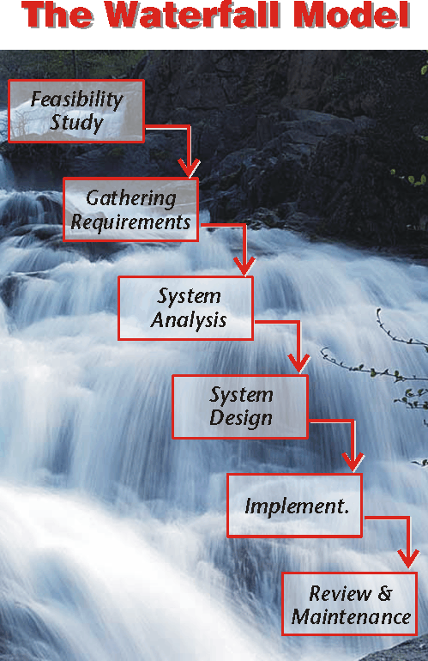

Slide 17
The Limits of Waterfall Model
Inflexibility
Cannot easily swim upstream
Over-Reliance on Documentation
Relies too much on documentation
Detachment from Technology
“One size” methodology cannot fit all technologies.
Detachment from Marketplace
Slow-paced methodology.
Detachment from the Profession
Programming is not the same as assembly of cars or baking breads, nor programmers work the same way as manufacturing workers or bakers.

Slide 18
Prototyping
Prototyping is the creation of a working model of the essential features of the final product for testing and verification of requirements.
There are two types of prototyping: incremental or evolutionary and throwaway.

Slide 19
Incremental and Iterative Approach
In incremental development, the product is built through successive versions that are refined and expanded with each iteration
Three concepts underlie the incremental approach:
The Initialization Step
The Control List
The Iteration Step

Slide 20
Throwaway Approach
In the incremental approach,
the initial prototype is revised and refined repeatedly until it becomes the final product.
In the throwaway approach,
the prototype is discarded after the stakeholders in the development are confident that they have arrived at the correct specifications and the development on the “real” product can start.

Slide 21
Problems with Prototyping
Unbalanced Architecture
Since the main thrust of prototyping is towards the user interface, the developers tend to include more and more functionality in the outer layers of the information system, creating a distorted architecture.
The Illusion of Completeness
Since the clients might not understand why the developers insist that a lot more is to be done, the prototype may successfully present the user interface for a complex functionality the feasibility of which is far from certain.
Diminishing Changeability
Since prototyping can leave little trace of how the development evolved, modifying the application can resemble an archeological undertaking to piece together a lost civilization.
Prototyping can result in too little documentation or, more importantly, too little modeling.

Slide 22
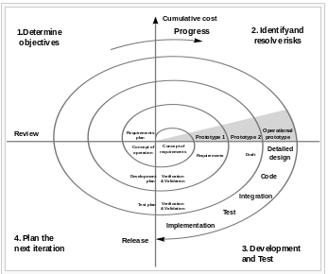
The Spiral Model
The spiral model is a risk-oriented lifecycle model that breaks a software project up into mini-projects.

Slide 23
Rapid Application Development (RAD)
Rapid Application Development is selecting techniques, methods, practices and procedures that would result faster development and shorter schedules.

Slide 24
Characteristics of RAD
Requirements Planning
Aims at eliciting information and requirements from the senior people and verifying the goals.
Design
The design phase begins once the top-level requirements of the system are identified. To discover more detailed requirements, RAD relies on Joint Application Development (JAD) workshops.
Implementation
Once the users approve the preliminary design, a detailed design of the system is created and code is generated. Implementation phase is heavily dependent upon CASE tools.
Enhancements and Maintenance
In the framework of RAD, a software is never completed until it is retired.
there is no significant difference between development and maintenance. (This position is in opposition to most SDLC methodologies.)

Slide 25
Agile Methodologies
Agile methodologies aim at being adaptive rather than predictive.

Slide 26
Extreme Programming (XP)
A better-known example of agile methods, and one of the earliest ones, is Extreme Programming (XP).
XP has a set of clear-cut practices that can be grouped in four categories:
Planning
Designing
Coding
Testing

Slide 27
Extreme Programming (XP)
Planning
user stories
release plan
pair programming
Designing
CRC cards (Class-responsibility-collaboration )
Spike solutions
refactoring
Coding
collective ownership
sequential integration
no overtime
Testing
Unit testing
Acceptance testing
Integration testing

Slide 28
The Capability Maturity Model (CMM)
CMM aims to measure the maturity of software development process within an organization.
CMM is essentially a rating and auditing framework of standards.

Slide 29
Maturity Levels of CMM
Initial (or ad hoc).
Focus: Individual Effort
Repeatable.
Focus: Project Management
Defined.
Focus: Engineering Process
Managed.
Focus: Product & Process Quality
Optimizing.
Focus: Continuous Process Improvement

Slide 30
Software Modelling

Slide 31
Modeling
Modeling, as a methodology, is the systematic representation of the relevant features of a product or a system from particular perspectives.

Slide 32
Modeling for Software Development
Software modeling is shaped by four interweaved factors:
❶ how the real world is seen,
❷ how software is defined,
❸ the process of development, and
❹ the modeling language.

